Slide 1
Data Analytics Bootcamp Project
By: Tsz Yan, Chan (Annika)

Slide 2
Filipino Family Income and expenditure
Source: https://www.kaggle.com/grosvenpaul/family-income-and-expenditure
The Philippine Statistics Authority (PSA) spearheads the conduct of the Family Income and Expenditure Survey (FIES) nationwide. The survey, which is undertaken every three (3) years, is aimed at providing data on family income and expenditure, including, among others, levels of consumption by item of expenditure, sources of income in cash, and related information affecting income and expenditure levels and patterns in the Philippines.
Content
Selected variables from the latest Family Income and Expenditure Survey (FIES) in the Philippines
More than 40k observations and 60 variables which is primarily comprised of the household income and expenditures of that specific household
Last updated: October 2017 (as of January 12, 2018)

Slide 3
Reasons and questions for this dataset
This dataset is really interesting because it provides details of the Filipino’s household income and expenditures, which is not popularly studied. It allows users to be more knowledgeable about how another country’s citizens spend their money and what they spend it on in comparison to our own.
What is the relationship between the Filipinos’ household income and their expenditures, family structures, and household/ living standards?
Are total household necessities different across regions?

Slide 4
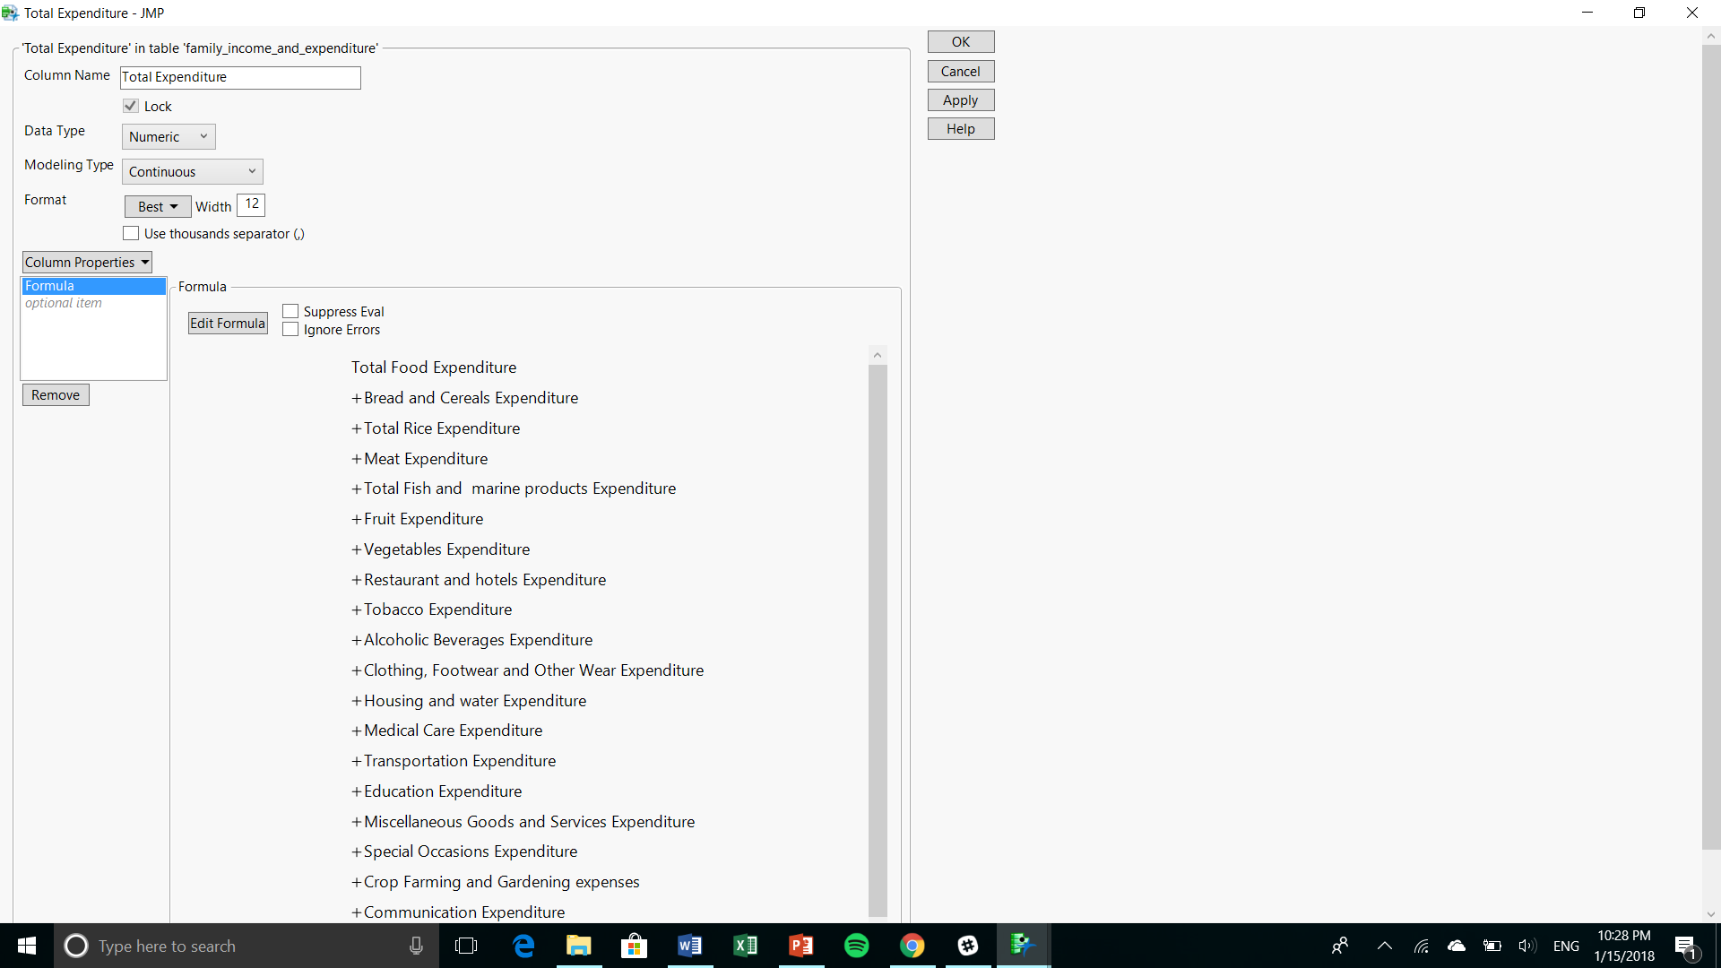
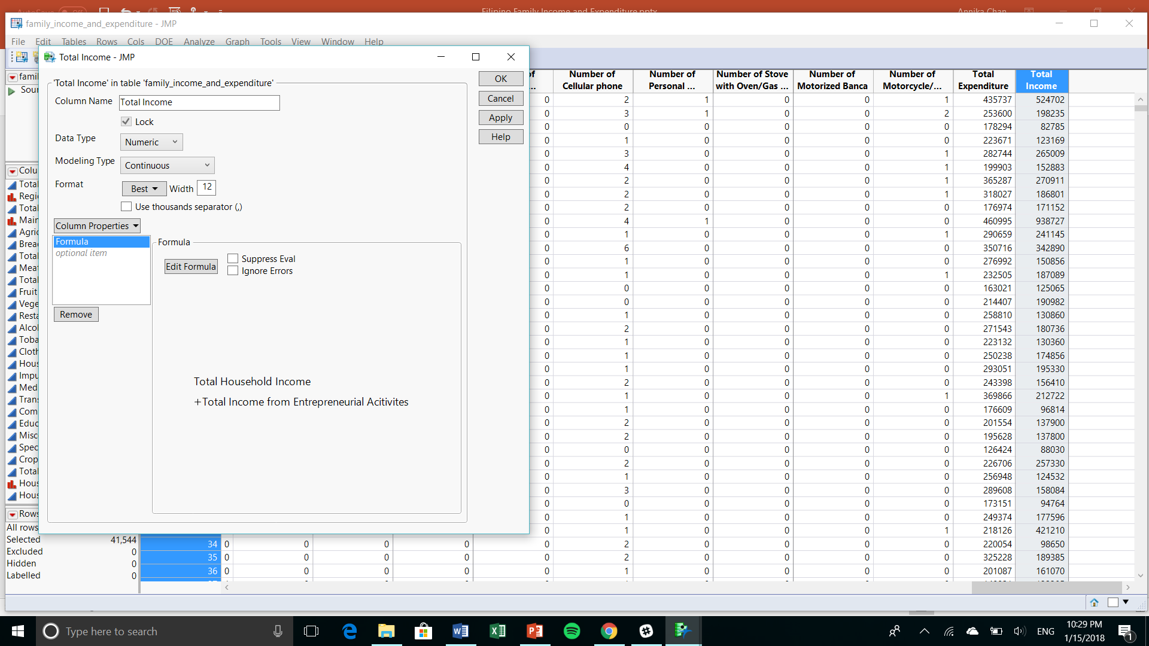
Data preparation
Combined existing columns into new ones for better and more accurate calculations in JMP.

Slide 5
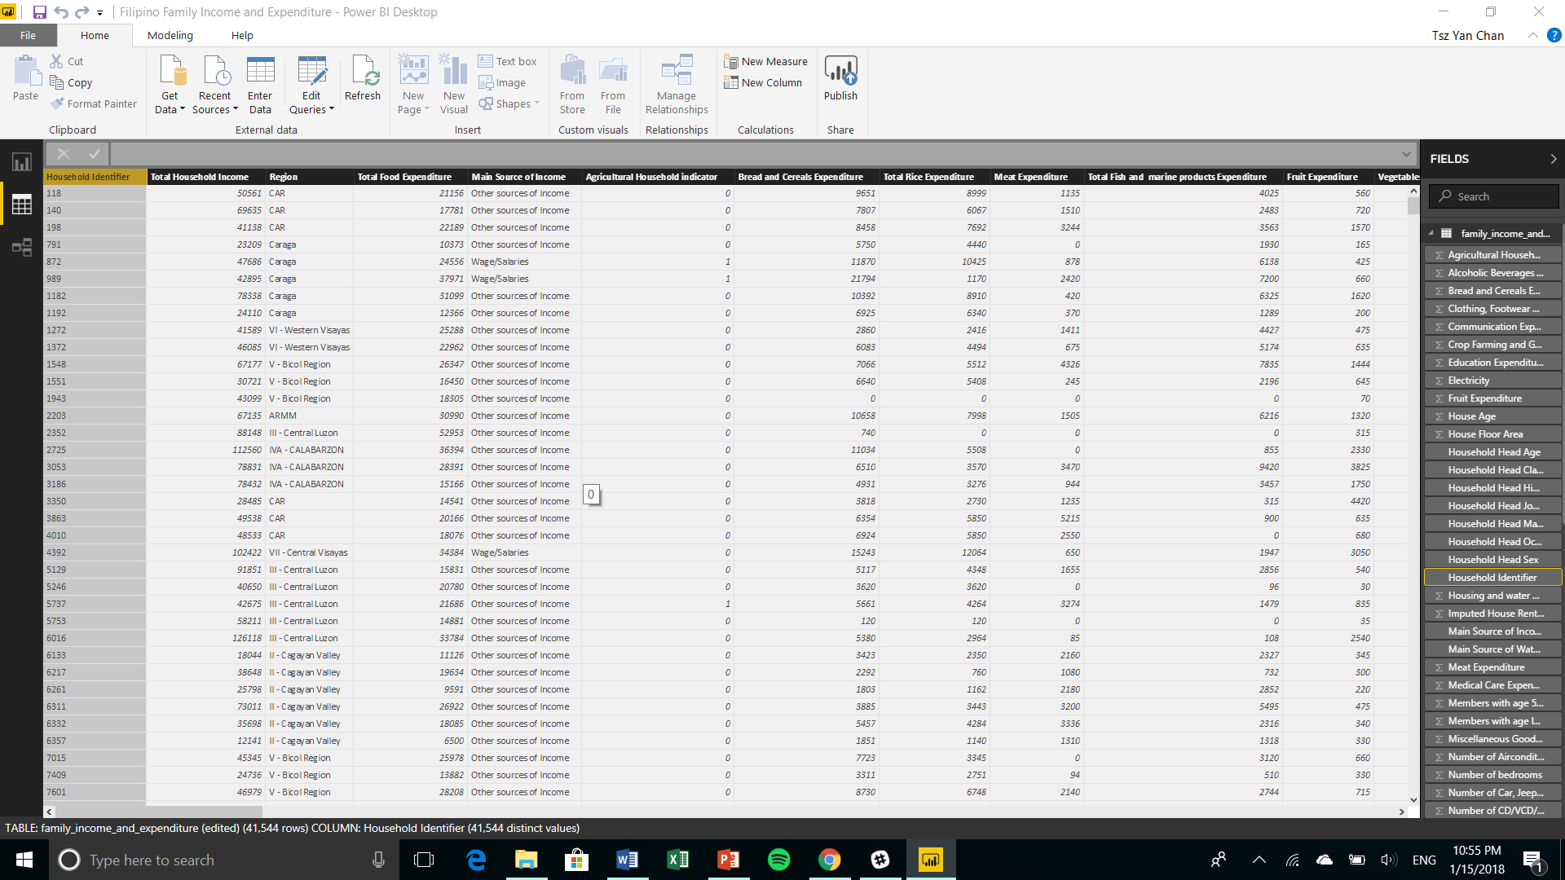
Added a column of household identifier to associate the related information to specific household for better visualization in Power BI later on.

Slide 6
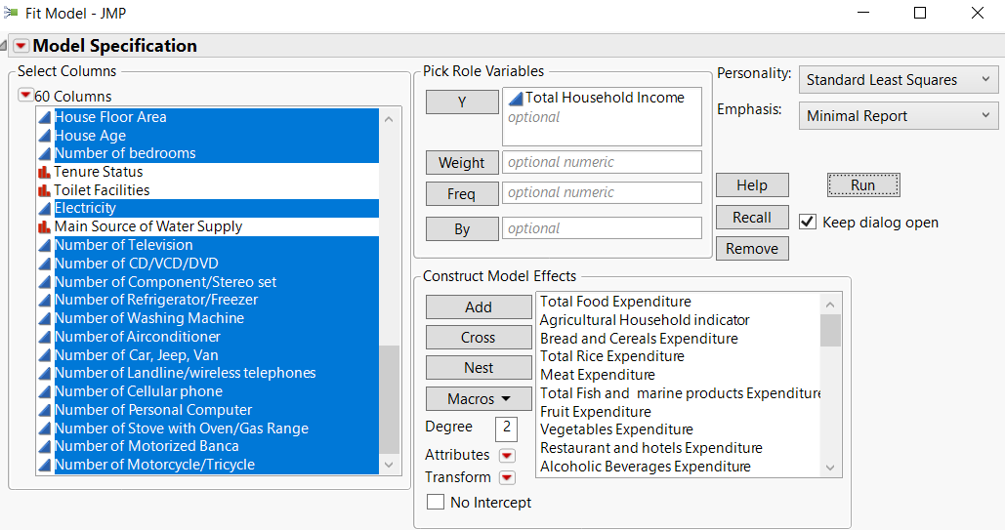
Multiple REGRESSION
Utilized fit model in JMP to discover the relationship between total household income and many variables such as different expenditures, family structures, and household/ living standards.

Slide 7
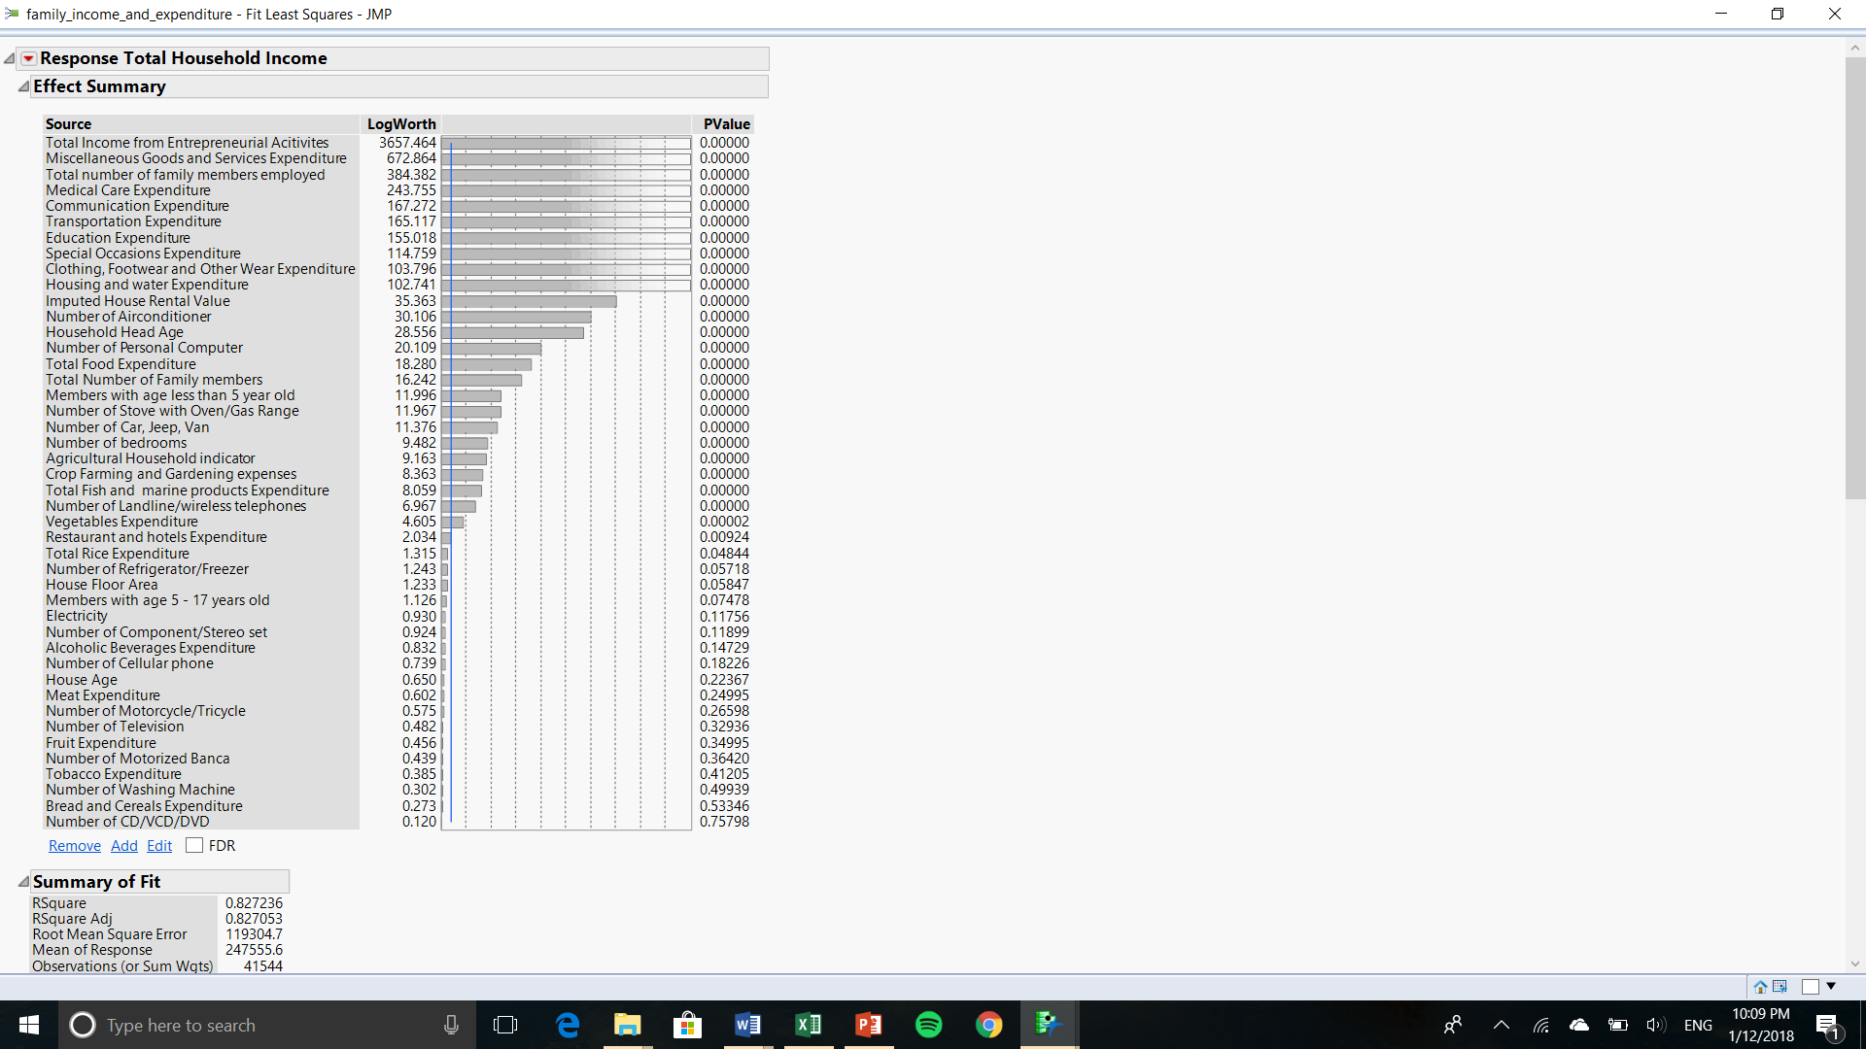
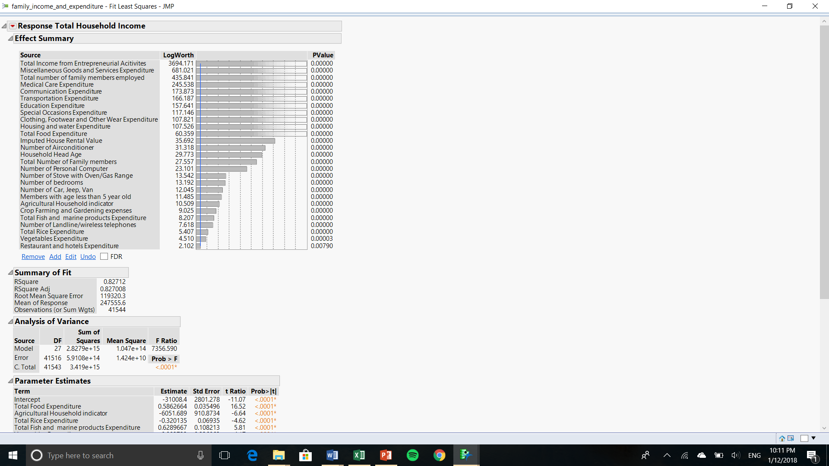
Before
After

Slide 8
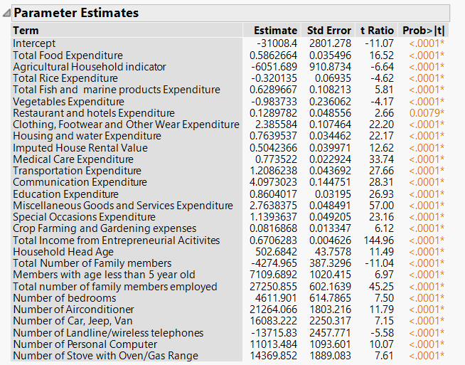
Multiple regression result
Total household income = (0.586)*total food expenditure – (6051.689)*agricultural household indicator – (0.32)*total rice expenditure + (0.629)*total fish and marine products expenditure – (0.984)*vegetables expenditure … + (11013.484)*number of personal computer + (14369.852)*number of stove with oven/gas range – 31008.4
The estimate column multiple by the corresponding variables from the screenshot on the left will provide the equation to calculate future/ unknown total household income.

Slide 9
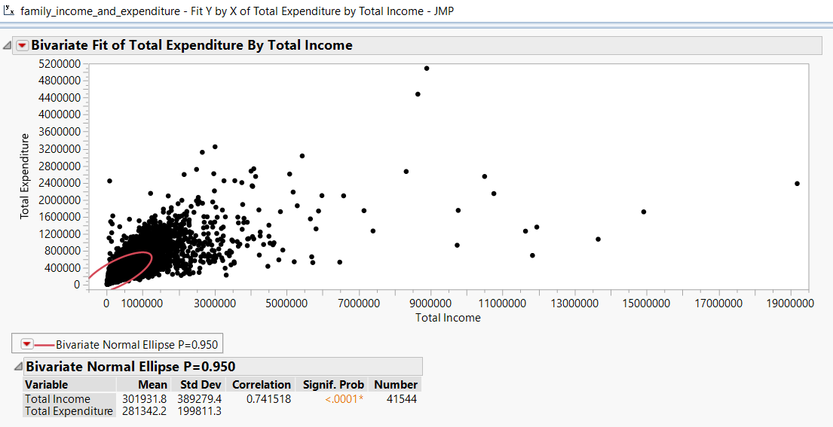
Fit y by x
*A relationship solely between income and expenditure columns listed in the data.
Total expenditure = ₱166,423.93 + (0.38)*total income

Slide 10
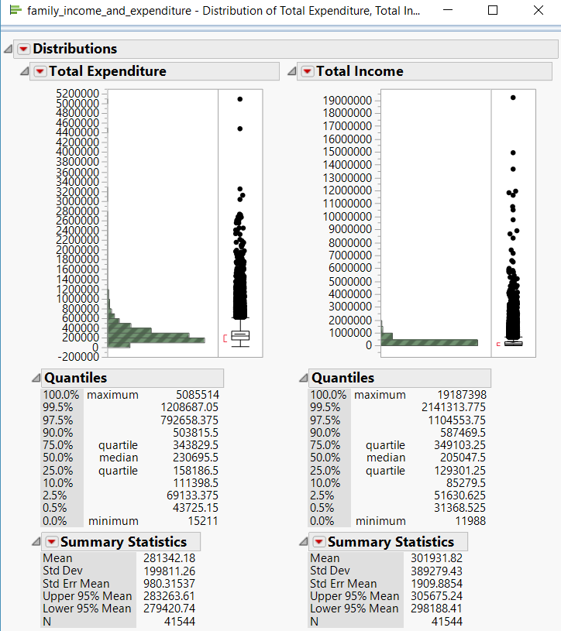
distributions
According to the total expenditure distributions graph, a household would have ₱230,695.5 expenses on average.
Utilizing the equation from the fit y by x model of total expenditure = ₱166,423.93 + (0.38)*total income. A household would need to make ₱169,135.71 on average to break even.

Slide 11
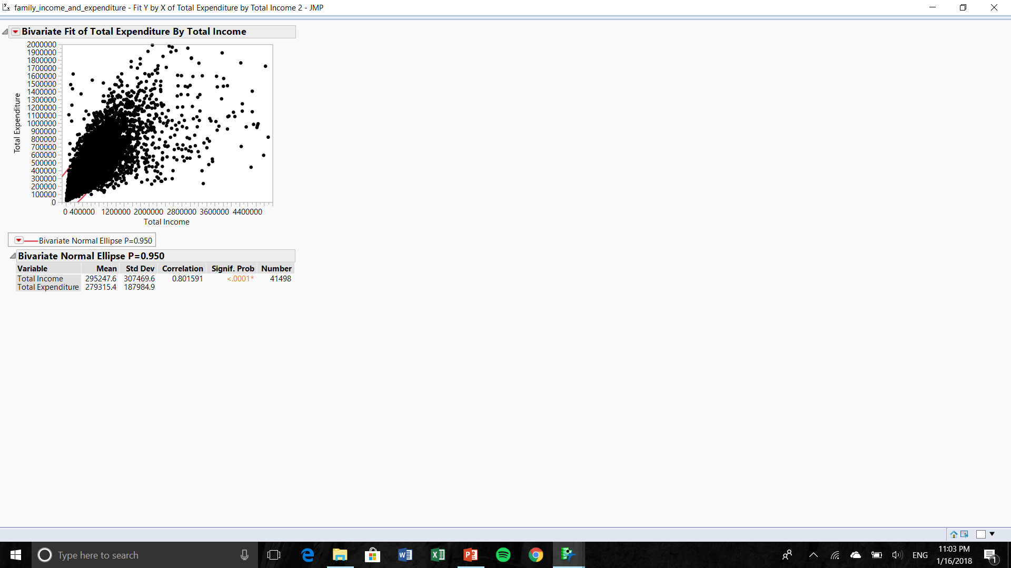
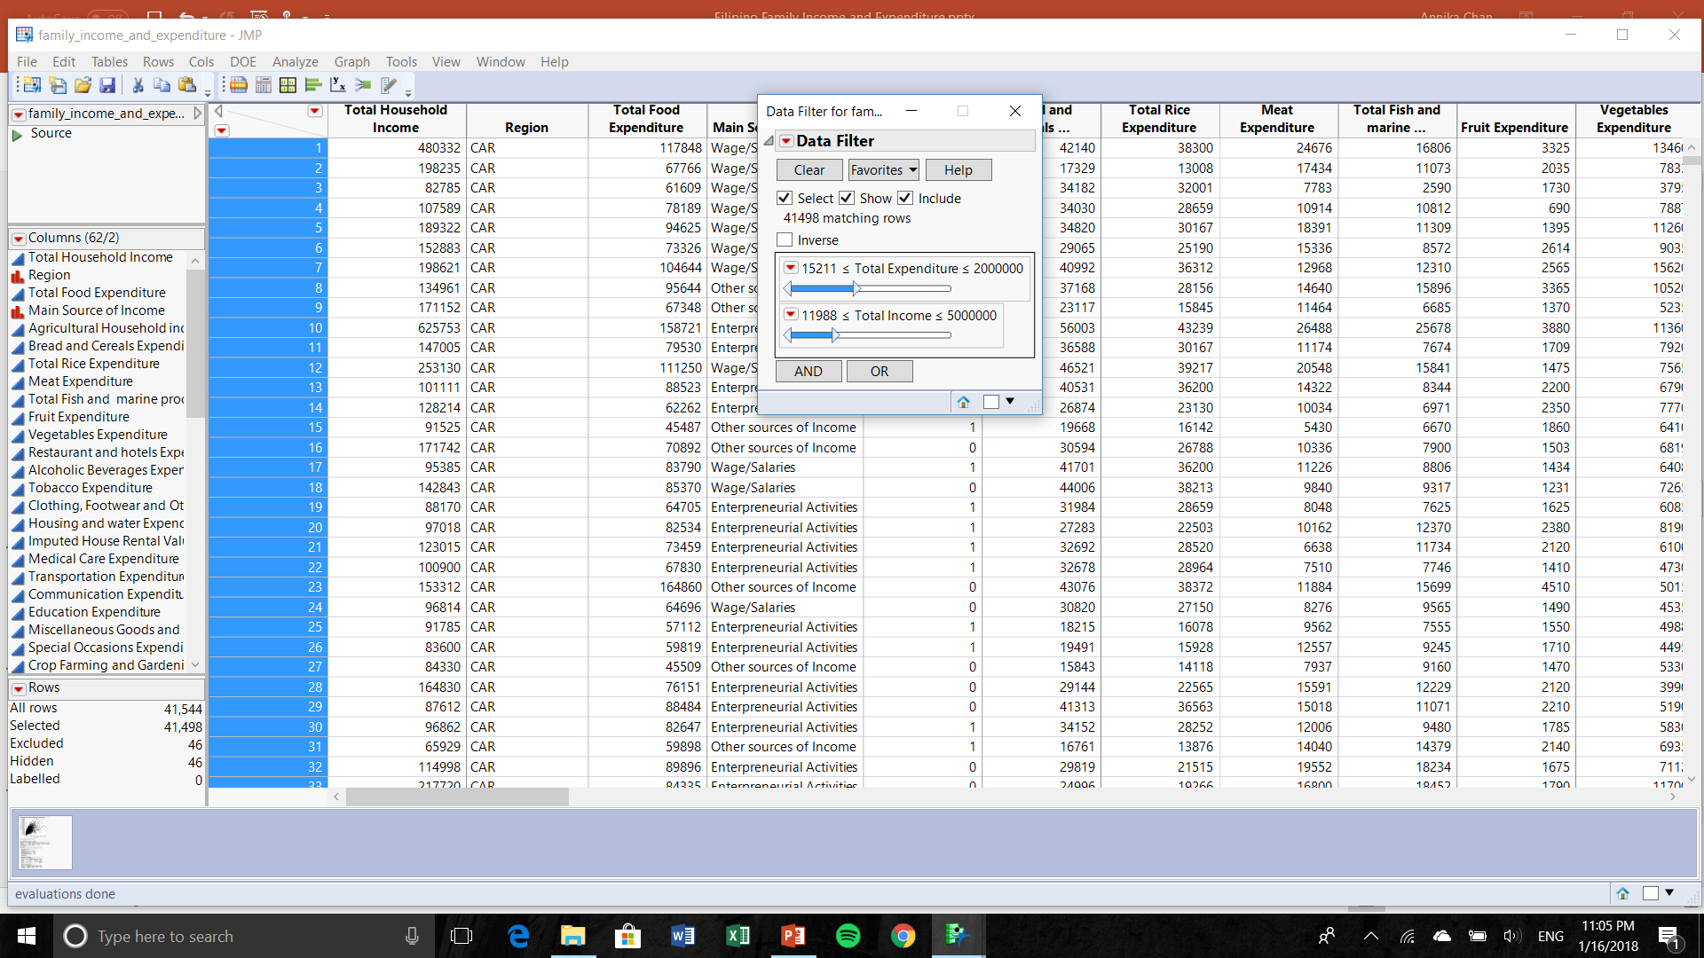
Better fit y by x model
Total expenditure = ₱134,618.33 + (0.49)*total income

Slide 12
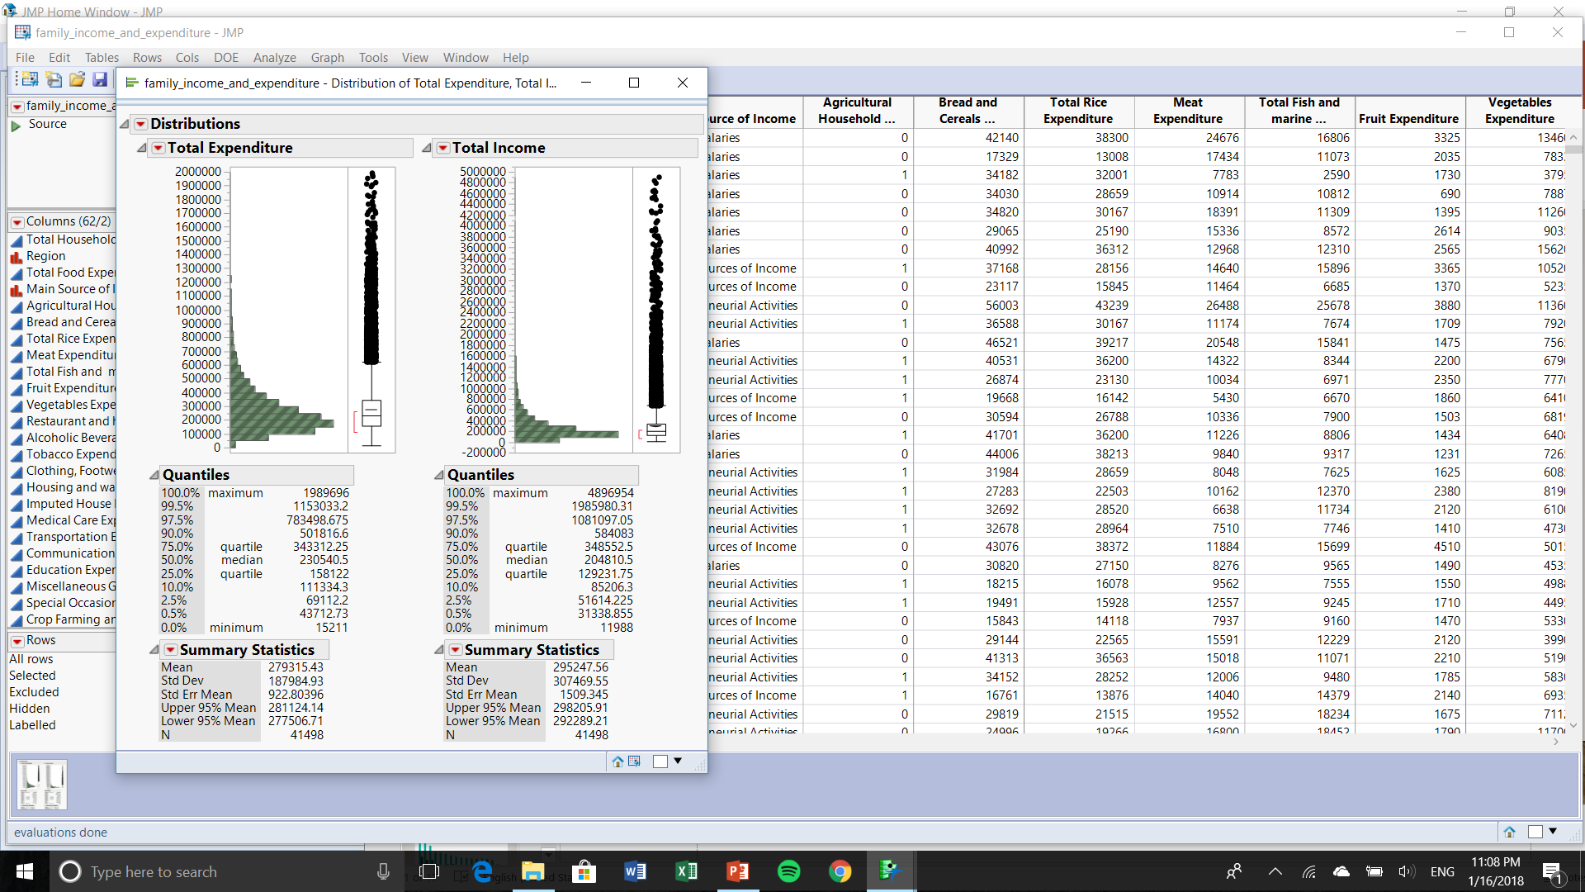
distributions
*This model eliminated the outliers from the previous analysis (slide 10). With the updated equation and distributions of total expenditure and total income, the model is better represented.

Slide 13
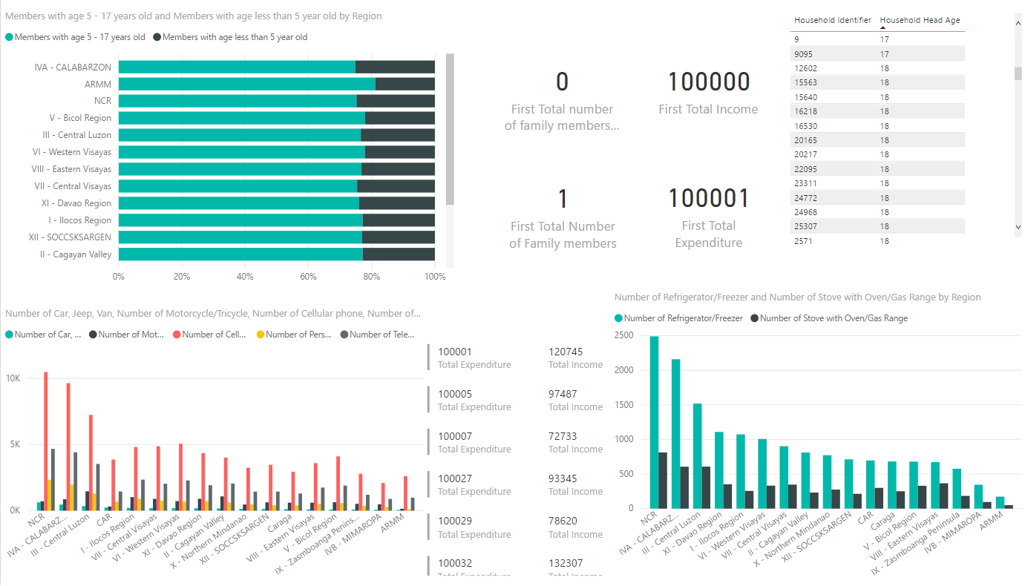
Data visualization in power bi

Slide 14
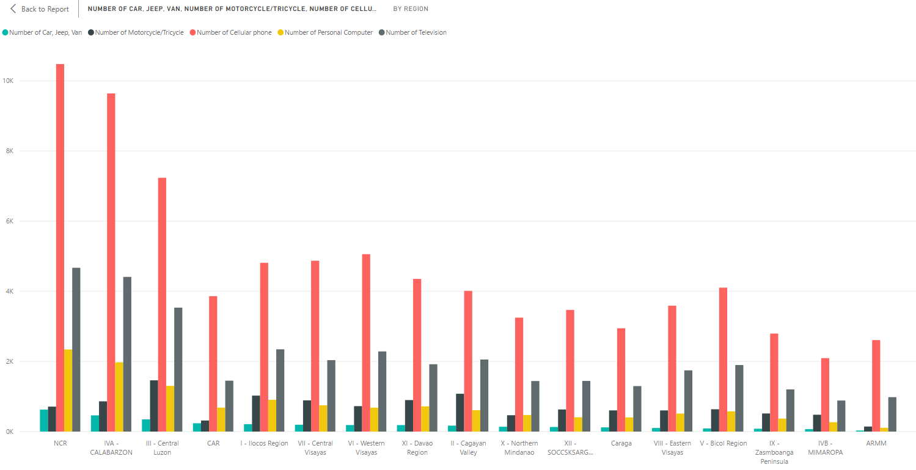
This graph shows the number of automobiles, motorcycles/ tricycles, cell phones, personal computers, and televisions that each region have.

Slide 15
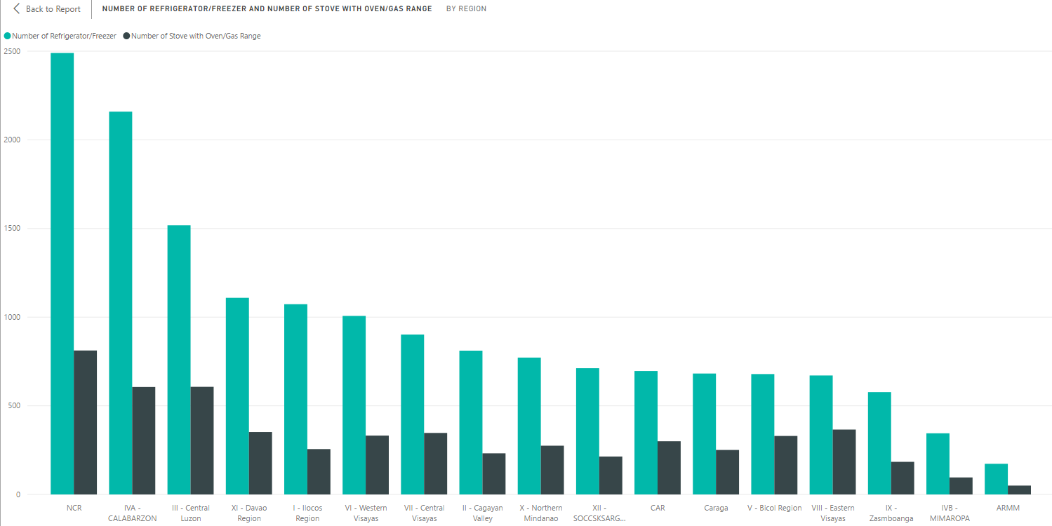
This graph shows the number of refrigerator/ freezer and stove with oven/ gas range that each region has.

Slide 16
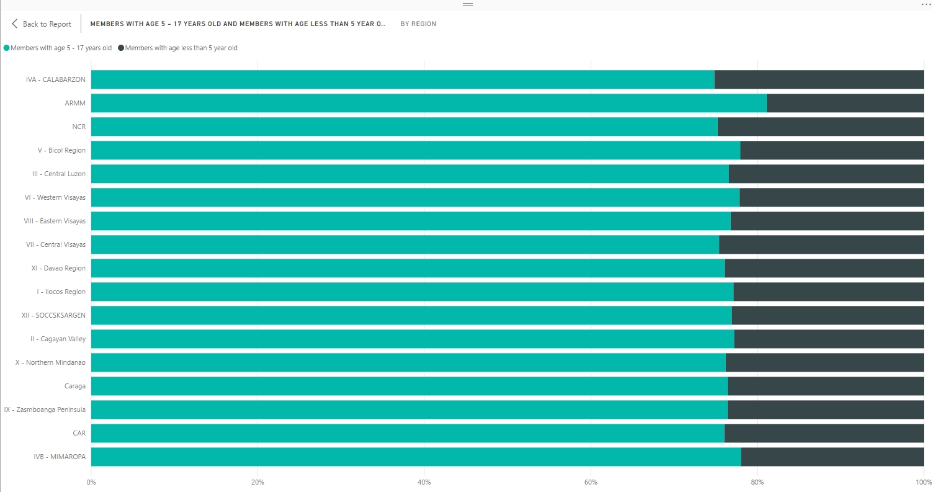
This stacked bar chart shows household with members of less than 5 years old or with members between 5 to 17 years old by region.

Slide 17

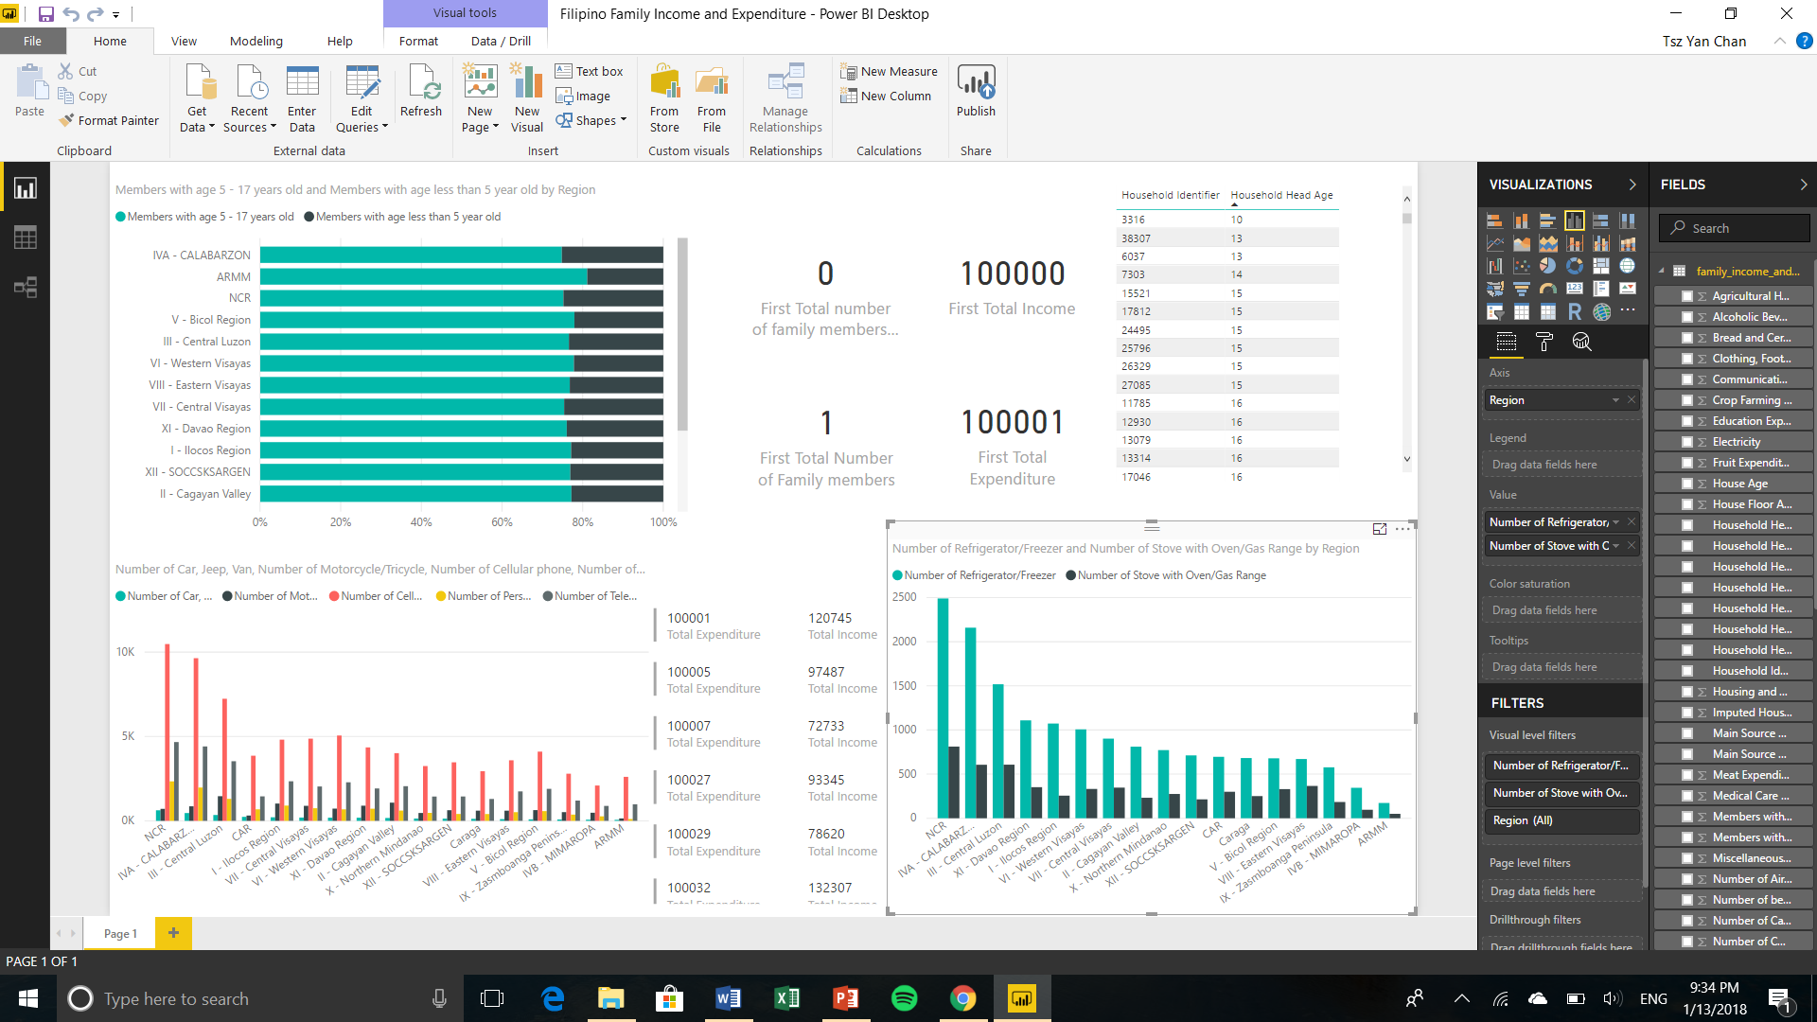
These cards and table display interrelated information with the rest of graphs in the data visualization Power BI screenshot. When a specific household identifier, household head age, total expenditure, or total income information is selected, all the cards and table show the rest of the related information of that specific household.

Slide 18
Questions answered
What is the relationship between the Filipinos’ household income and their expenditures, family structures, and household/ living standards?
The multiple regression result shows the relationship between total household income and various factors that affect it, including and not limited to different expenditures, family structure, and household necessities (slide 8).
The fit y by x result shows the relationship only between total household income and total expenditure (slide 9) which are columns created/ calculated from the data preparation process (slide 4). A better result is shown on slide 11 after removing some outliers within the original data.
Are total household necessities different across regions?
As shown in the Power BI visualization (slide 13), different regions have unique necessities. For example, NCR consistently has the most number of product consumptions in graphs on slides 14 and 15. That is also true for half of the regions on the graphs. Therefore, household necessities are different across regions and more information would be needed to further analyze the underlying relationship between the power of consumption and the regions’ consumption.

